Slide 1
Spring 2017 CSE 5911
Strategic Operations Center
Cyriac Domini, Daniel Bedich, Shantanu Bhardwaj, Asanka Nanayakkara

Slide 2
NetJets Flight Dashboard
Project Name: Strategic Operation Center
Point of Contact
Umesh Vaswani
Software Architect at NetJets
Perumal Ramasamy
Professor and VP at NetJets

Slide 3
Problem Statement
“Our organization has hundreds of flights that are flown each day. We would like to build an application that is a dashboard of our critical flights, with ability to identify critical issues. And this tool shall have the ability for the SOC members to communicate among themselves to resolve critical issues. The application shall have the following features:”
a. Publish /subscribe functionality so that as the data changes, user’s screens are updated immediately. b. Tracking communication among SOC members and associating communications with key entities c. Dashboard for flights to identify critical issues d. Ability to search past communications

Slide 4
Problem Statement
Create a dashboard that displays flights with critical issues and their possible backups, has chat capabilities, and has real time view updates.

Slide 5
In Scope
Adding/Removing critical flights
Adding/Removing recovery options
Filtering/Searching flights
User actions
User authentication
Chat
User based
Entity based (Flight/Problem)
Automatic update functionality

Slide 6
Out of Scope
Integration with NetJets databases
Active directory group sign in (SSO)
Searchable chat
Customized dashboard views for different roles

Slide 7
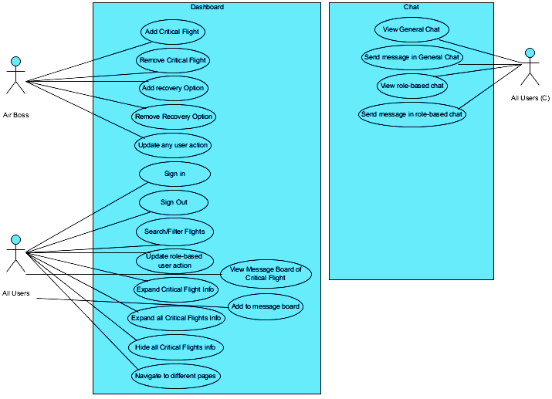
Use Case Diagram

Slide 8
Key Deliverables
Diagrams
Architecture
Use Case
Class
Sequence
Finished Application with the following:
Login Page with proper functionality
Sample flights page with appropriate information
Working Chat
Documentation
User guide
Code detail
Final Presentation
Poster

Slide 9
Assumptions
Continued weekly meetings with developers and sponsor
Continued commitment from team
Working development tools
VirtualBox
Ubuntu
Docker
DataTables
Firechat/Firebase
ActionCable

Slide 10

Resources
Stack Overflow
ActionCable
Docker and DockerCompose
JQuery DataTables
Google’s Firebase
Firechat
Sponsor

Slide 11
Risks
Running out of time
Time Management
Taking Advantage of Spring Break
Forgoing Styling
Failing at Integrating Firechat/Needing to make our own chat
Change focus/pivot/revert to custom chat
Choosing an ideal testing methodology/software suite for integration, user, and unit testing
Trial and error, having the will to do it

Slide 12
Issues/Constraints
Time
Spring Break
Chat integration, many failed attempts
Browser Compatibility
Firechat API and documentation
ActionCable documentation

Slide 13
Dependencies
Auto UI updates
Rails 5 with ActionCable (websocket implementation)
Dashboard
jQuery Datatables
Ruby Gems
Devise, Json rails
Firebase/Firechat (for now)
OS/Software
Ubuntu 16.04 (or any UNIX based OS) with terminal and text editor
Docker
Rails 5
Heroku Server for deployment
Ruby jUnit Testing framework (in progress…)
Front end testing framework (in progress…)

Slide 14
Tasks Accomplished
Login Authentication
Fully Functional Dashboard
Adding/Removing Critical Flights
Adding/Removing Recovery Options
Filtering/Searching
User Actions
Basic Firechat Integration
Real Time updates through Action Cable utilities

Slide 15
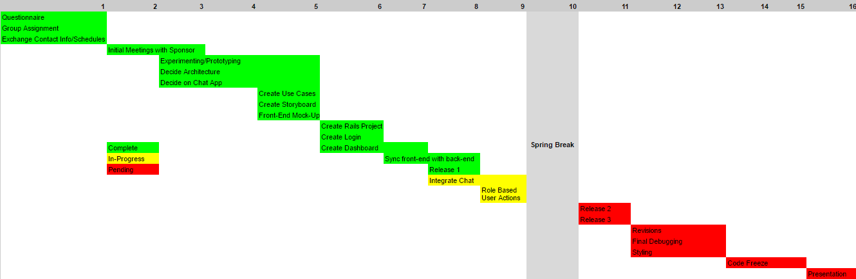
High-Level Plan

Slide 16
Tasks Planned
Finish Integrating Firechat
Create Message Board for each Critical Flight
Testing

Slide 17
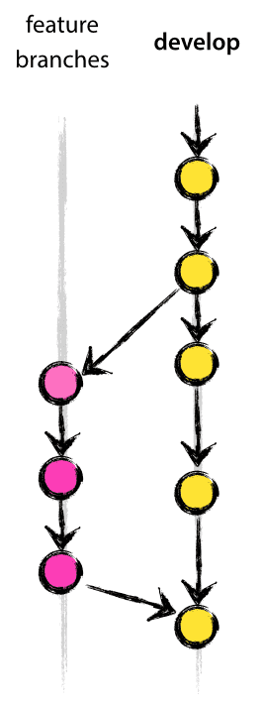
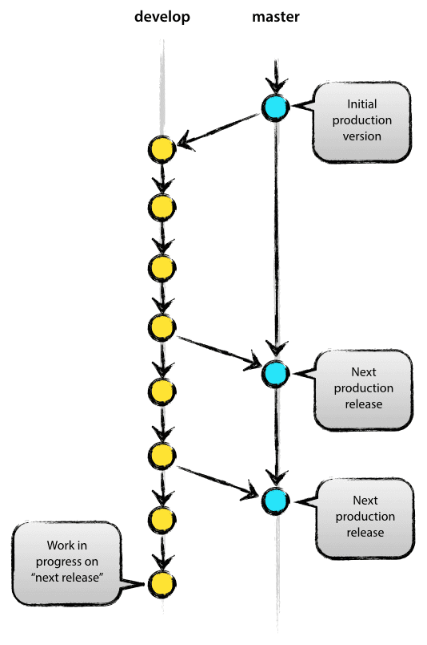
Project Management Methodology
Visual Studio Team Services
Git version control
Strict branching strategies
Agile
Frequent collaboration between team members
Unit Testing
Detailed documentation

Slide 18
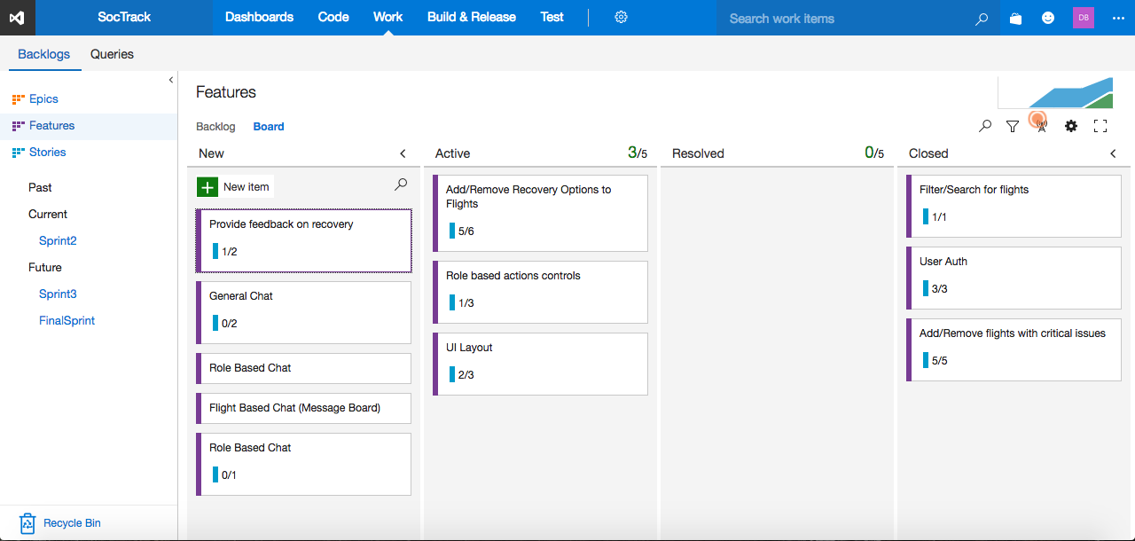

Slide 19
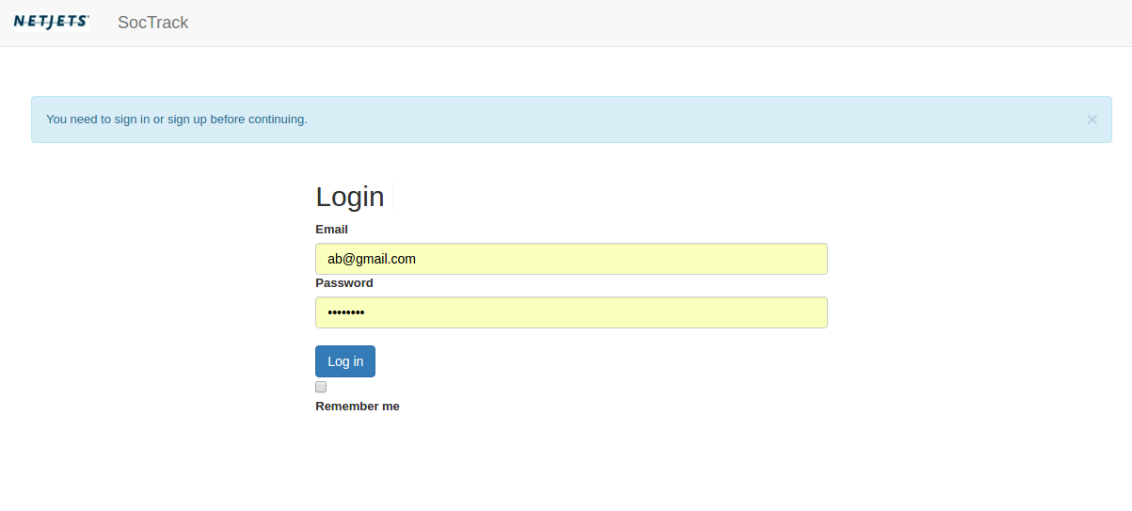
Screenshots

Slide 20
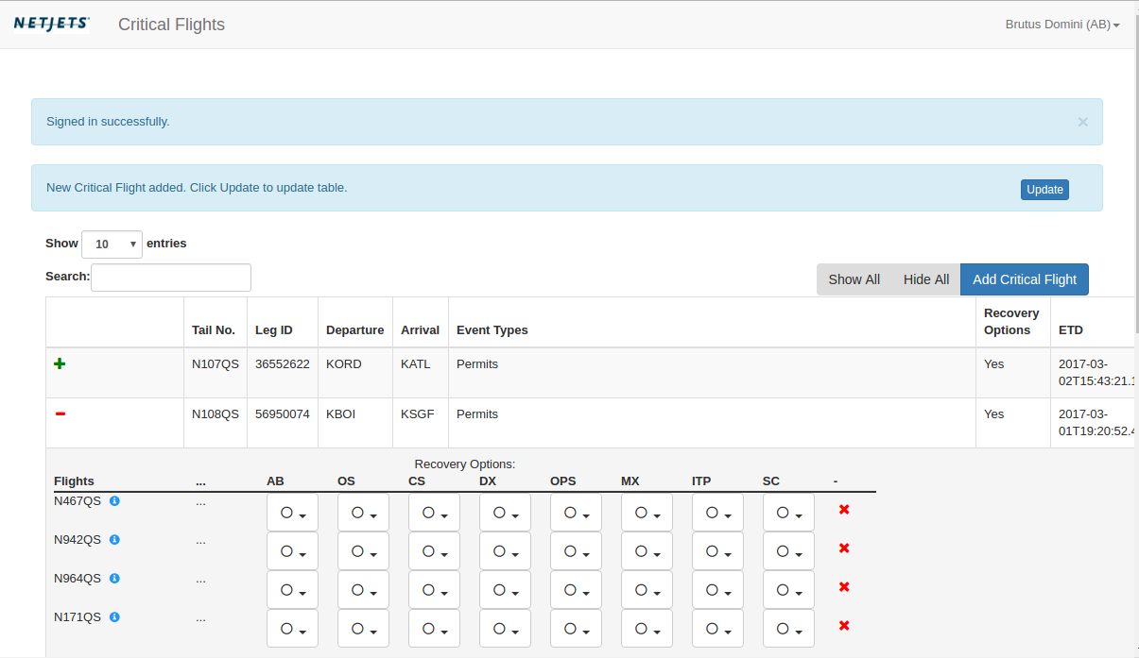

Slide 21
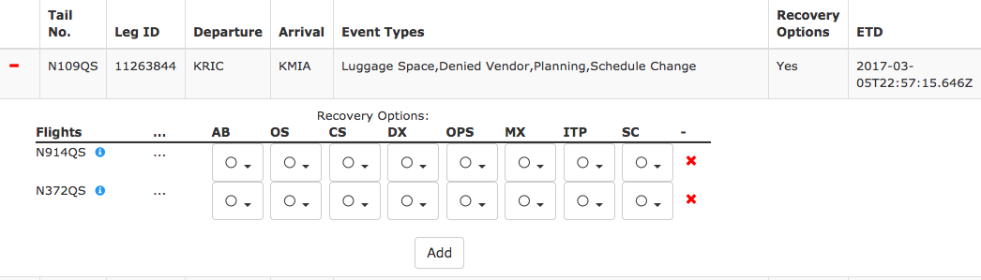

Slide 22
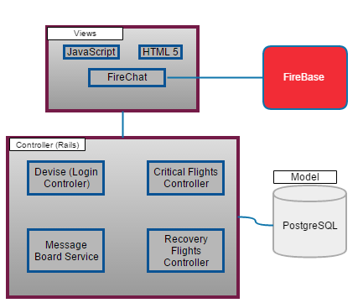
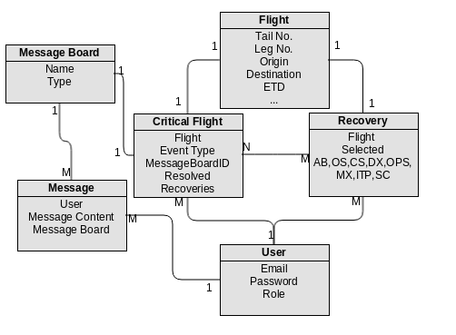
Architecture

Slide 23
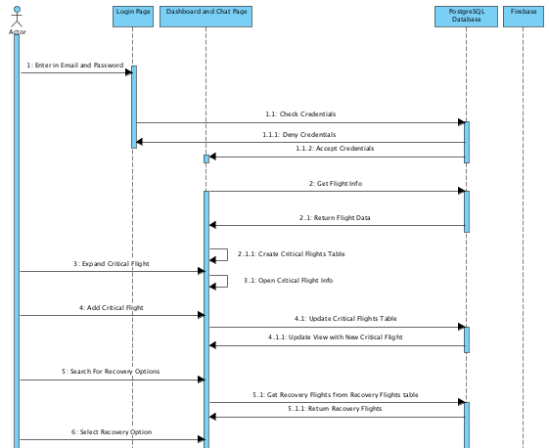
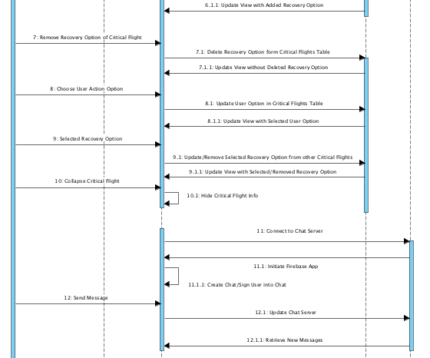
Sequence Diagram

Slide 24
Remaining Tasks
Finishing integrating FireChat or implement custom chat
Allowing users to chat with others of the same role
Allowing users to chat with others attached to their flight
Functionality to add recovery options
Adding message board to chat for each flight
Formulating and running test cases
Beta and user acceptance testing
Access controls based on user role

Slide 25
Demo
soctrackdev.herokuapp.com

Slide 26
Questions?

